Slide 1
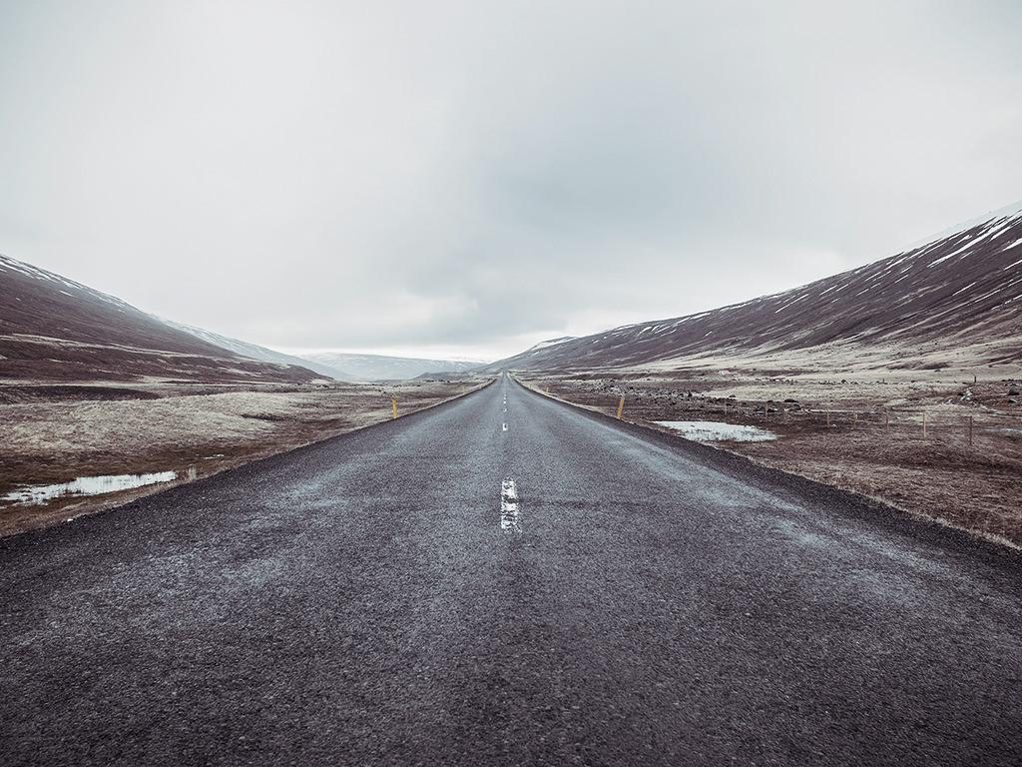
// .XPRESSION

Slide 2

Technology increases productivity… Right?

Slide 3
431,000
The number of people injured from distracted driving in 2014.

Slide 4
DISTRACTIONS
What features in a scene are correlated with distraction?

Slide 5
DISTRACTIONS
Who cares?

Slide 6
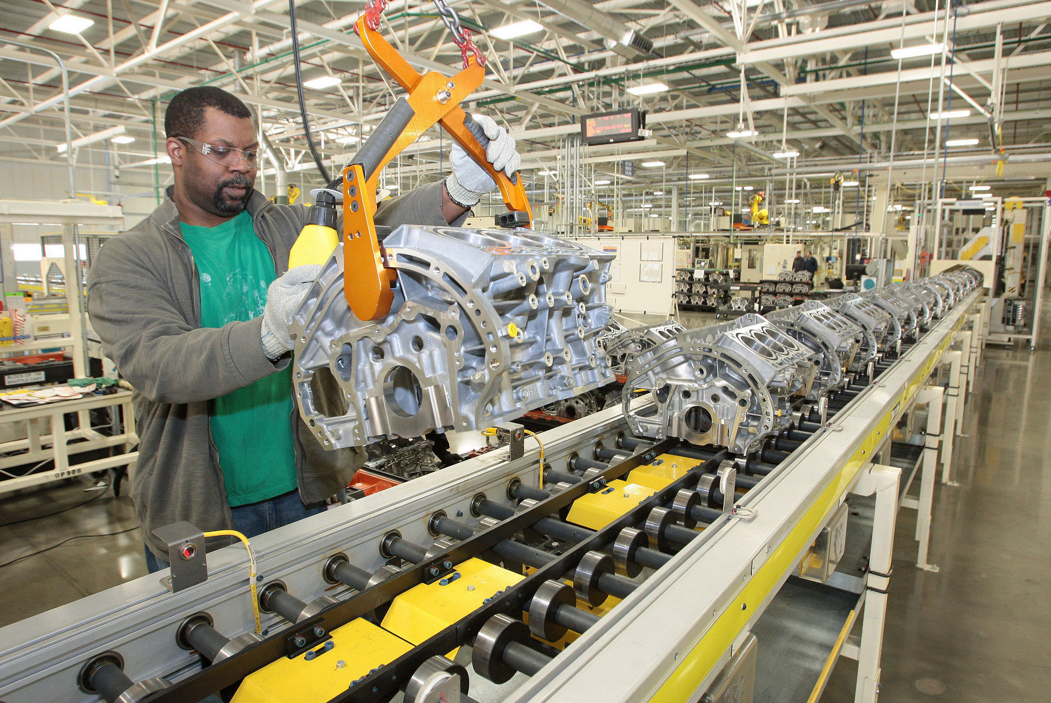
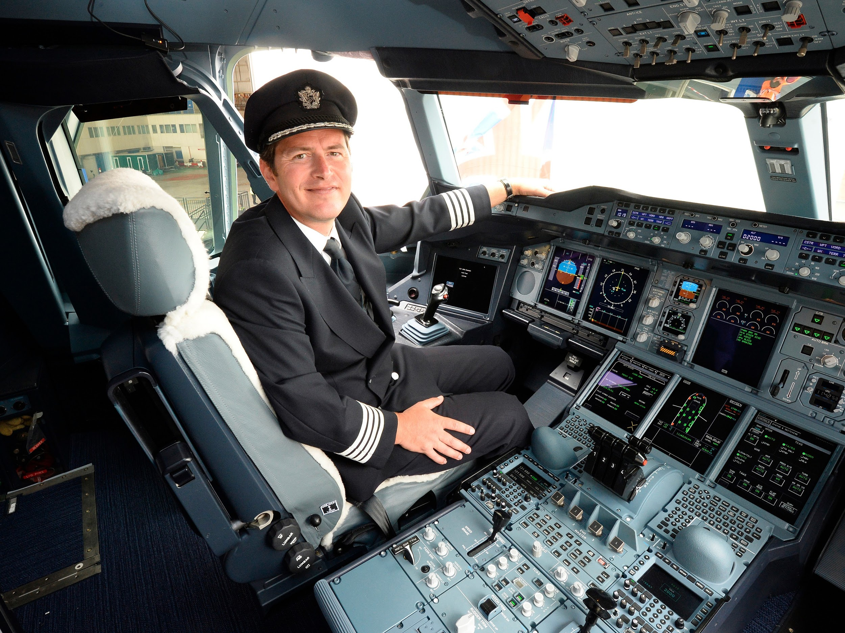
DISTRACTIONS
Who cares?

Slide 7







Market:

Slide 8




Tools:

Slide 9
THE PLAN
AWS Rekognition
Teradata DB
Aster DB

Slide 10
THE PLAN
AWS Rekognition
Teradata DB
Aster DB
Labelled Images
Python
JSON
SQL

Slide 11
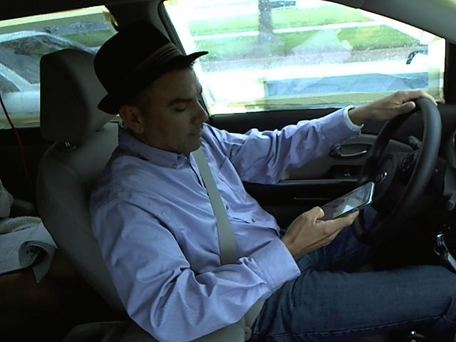
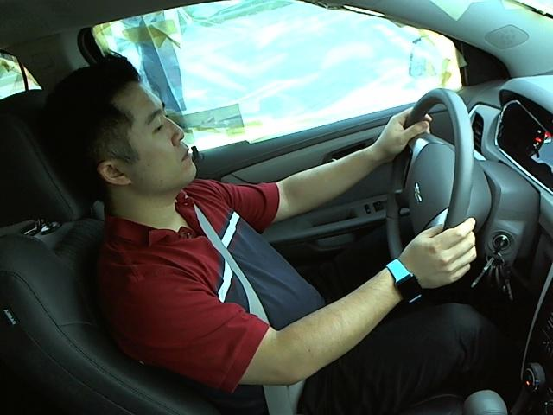
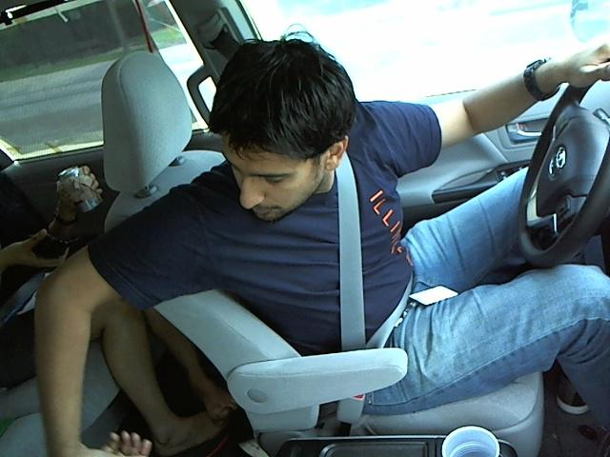
GETTTING DATA
Labelled Dataset from Kaggle (StateFarm Competition)
20,000 Images

Slide 12
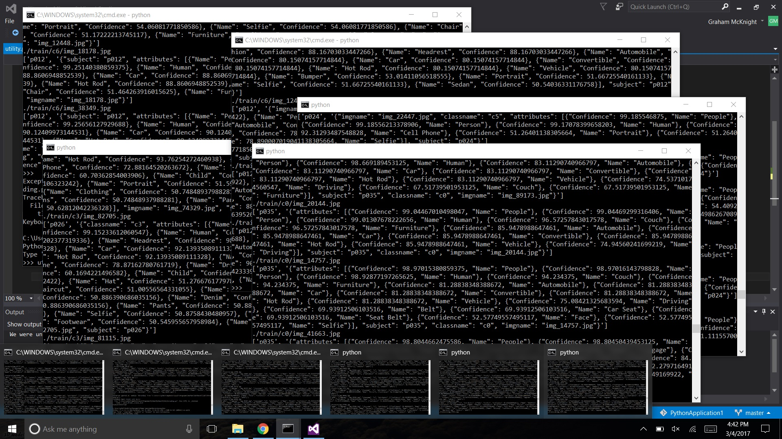
AWS Rekognition
Uploaded using Python scripts
More Python scripts to get several requests simultaneously

Slide 13
Teradata Database
First converted JSON from Rekognition to CSV (Python)
Reformatted to sort by Rekognition tags
Removed least common tags (Potted plant, Whale, Lingerie…)
Uploaded data to Teradata DB

Slide 14
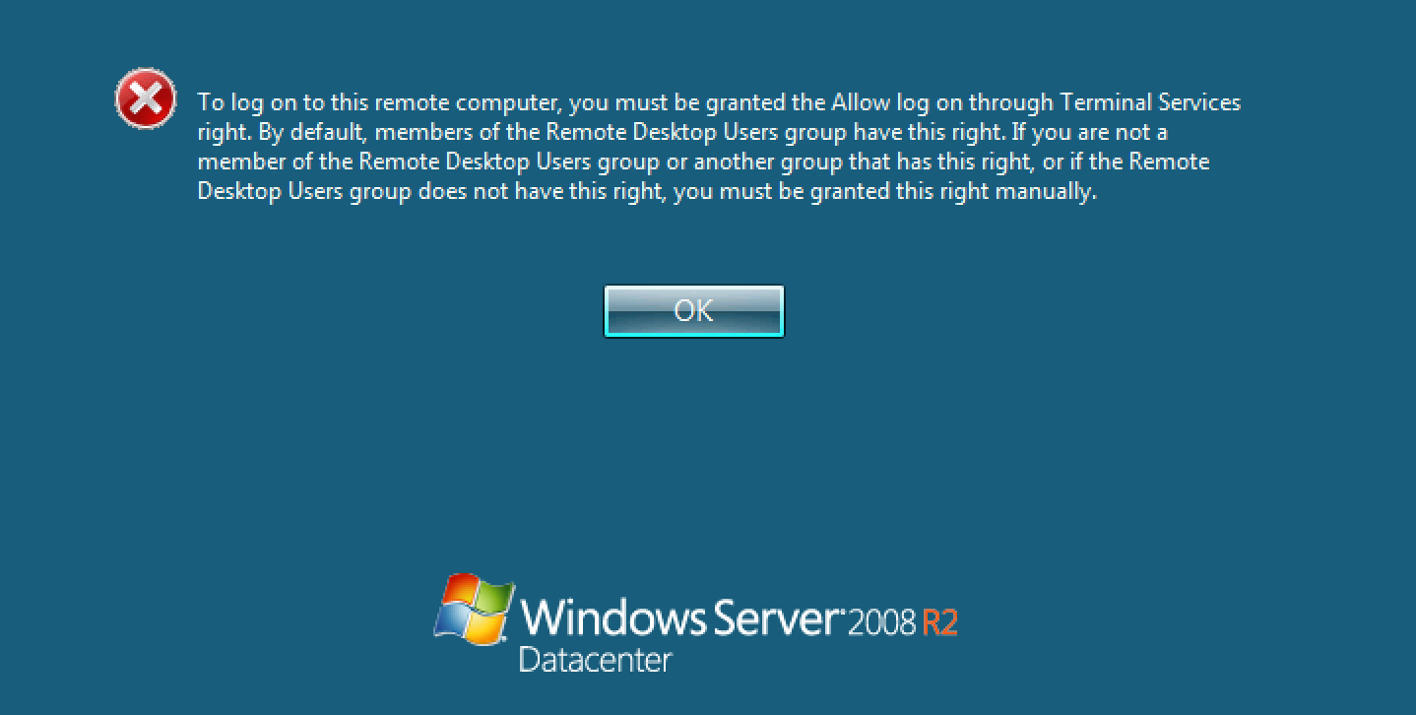
Aster Analytics
At first we saw a lot of error messages...

Slide 15
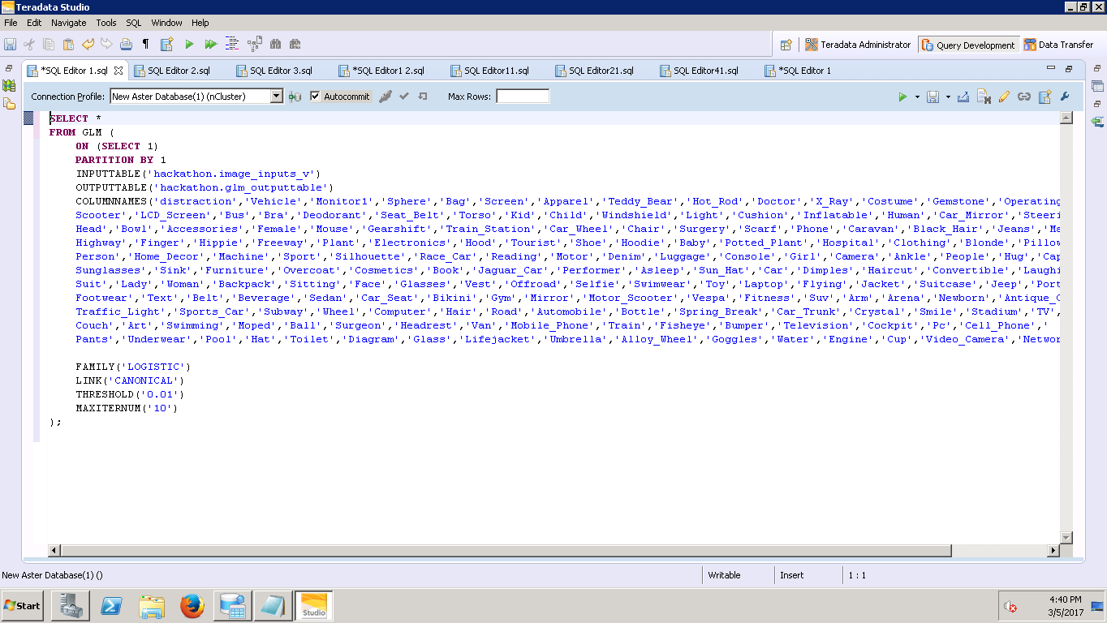
Aster Analytics
But ended up getting GLM working!

Slide 16
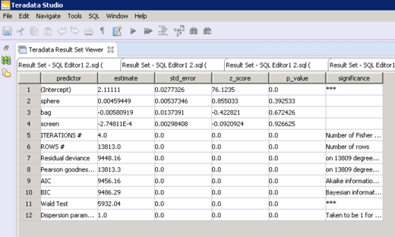
Aster Analytics

Slide 17
Credits:
Team TERALEXA

Slide 18
Credits:
Team TERALEXA

Slide 19
Credits:
Team XPRESSION:
Graham
JSON
Melissa
Luyanda
Andrew
Karan
Tam
Images and Presentation Templates:
mlive.com
CarnivalSlides.com
BusinessInsider.com

Slide 20
// .XPRESSION

Slide 21
The Road to Come

